Slide 1
Advance Data Sciences Final Project
Group 7:
Jyotirmayee Mahanandia
Aditya Madhav Shinde
Rachitha Dhanraj

Slide 2
Project Objective
Objective: The main objective of our project is to predict a crime incident that has the highest probability of occurrence at a given street, at a particular date and time using classification technique.
End User: Law Enforcement Agencies
Utility: The end users such as the Law Enforcement Agencies will be benefitted by the analysis and visualization of crime occurrence patterns.

Slide 3
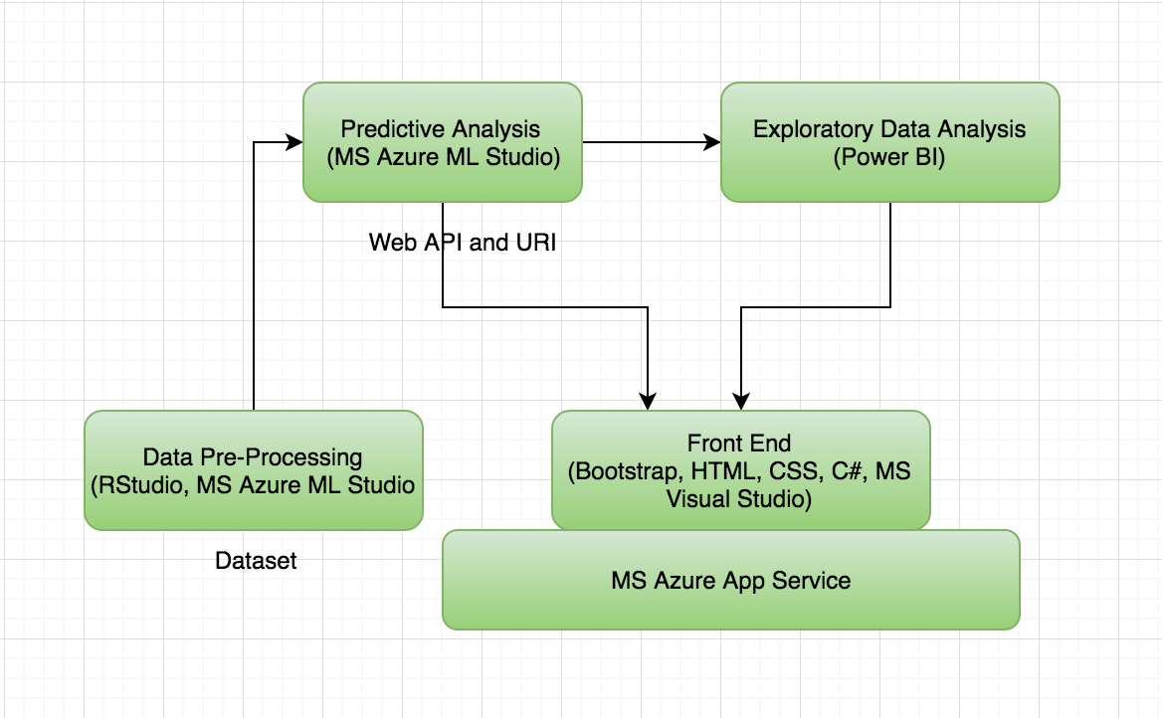
Architecture

Slide 4
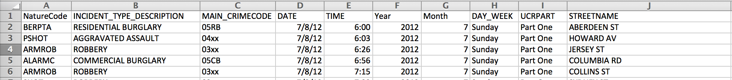
Dataset - Boston Crime 2012-2015
Nature code
Incident Type
MAIN_CRIMECODE
UCRPART
STREETNAME
DAY
TIME
Year
Month
DAY_WEEK

Slide 5
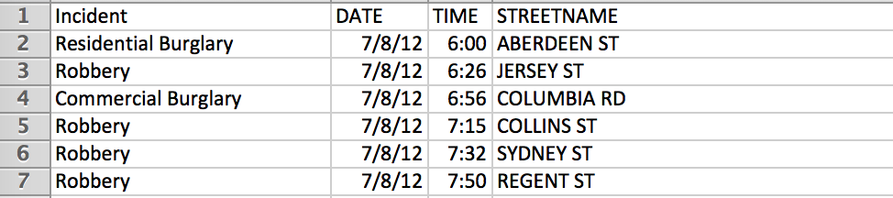
After Processing
Incident( 24 categories)
Date
Time
Street Name

Slide 6
Data Pre-processing
We used RStudio and MS Azure Machine Learning Studio for processing the dataset. The following steps were taken to clean and process the dataset:
Removed Null and blank values from dataset
Removed unwanted attribute from dataset
After pre-processing the dataset, we uploaded it on MS Azure Machine Learning Studio to clean missing values.

Slide 7
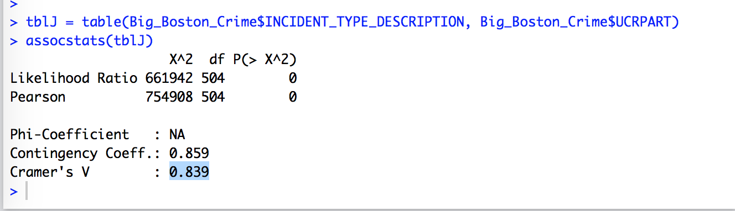
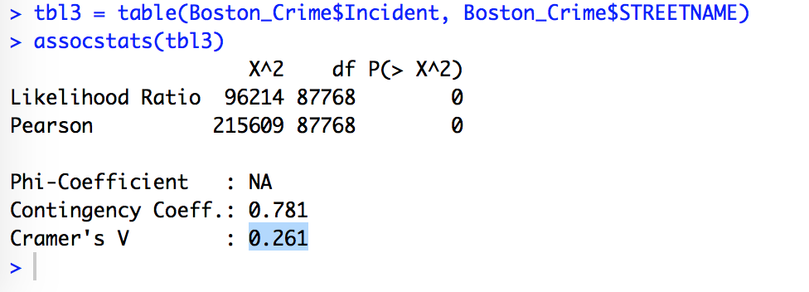
[I]Association
Cramer’s V association measure for categorical variables:
Effect of predictor variable UCRPART on INCIDENT TYPE outcome variable to find a high Cramer’s V value of 0.839
Effect of predictor variable STREET NAME on INCIDENT TYPE outcome variable to find a high Cramer’s V value of 0.261

Slide 8
[II]Classification:
The Machine learning modules used in building the predictive model were classification algorithms since the outcome variable considered is “incident-categorical variable” that has 24 different categories.
Multiclass Decision Forest
Multiclass Decision Jungle
Multiclass Logistic Regression

Slide 9
Model Evaluation
Multiclass Decision Forest:
Overall Accuracy = 0.32
Multiclass Decision Jungle:
Overall Accuracy = 0.31
Multiclass Logistic Regression:
Overall Accuracy = 0.34

Slide 10
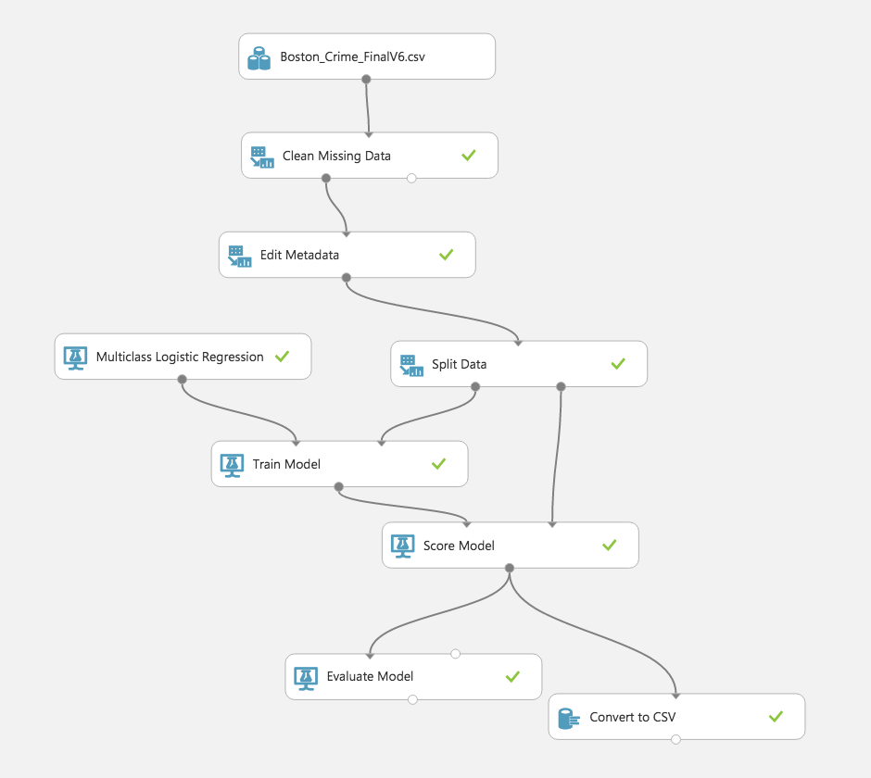
Building the Predictive Model:
The data was split into a 70:30 partition where 70% of the data was used for the training model and 30% was used for the scoring the.
The web service was deployed and the API key was obtained.

Slide 11
Demo and Exploratory Data Analysis
http://bostoncrimeanalysis.azurewebsites.net/

Slide 12
THANK YOU

